Slide 1

NCHC CA
APGrid PMA
Face-to-Face Meeting
Weicheng Huang
National Center for High-performance Computing
April 8, 2008

Slide 2
Introduction – NCHC
National Center for High-performance Computing
  Government supported research institute
    under NARL
    NARL : National Applied Research Laboratories
      government supported non-profit organization
      Funded by National Science Council (NSC)
Currently, there are 3 sites
  Resource distributed
  Management coordinated
  Suitable for Grid environment
ISO9001, ISO27001

Slide 3
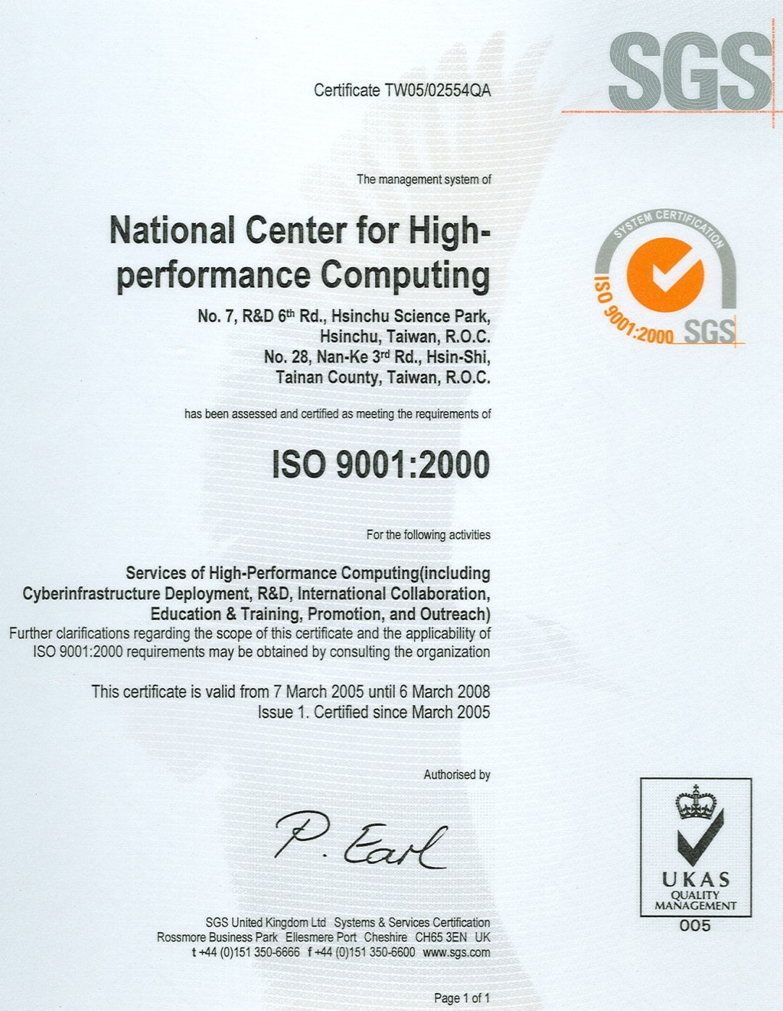
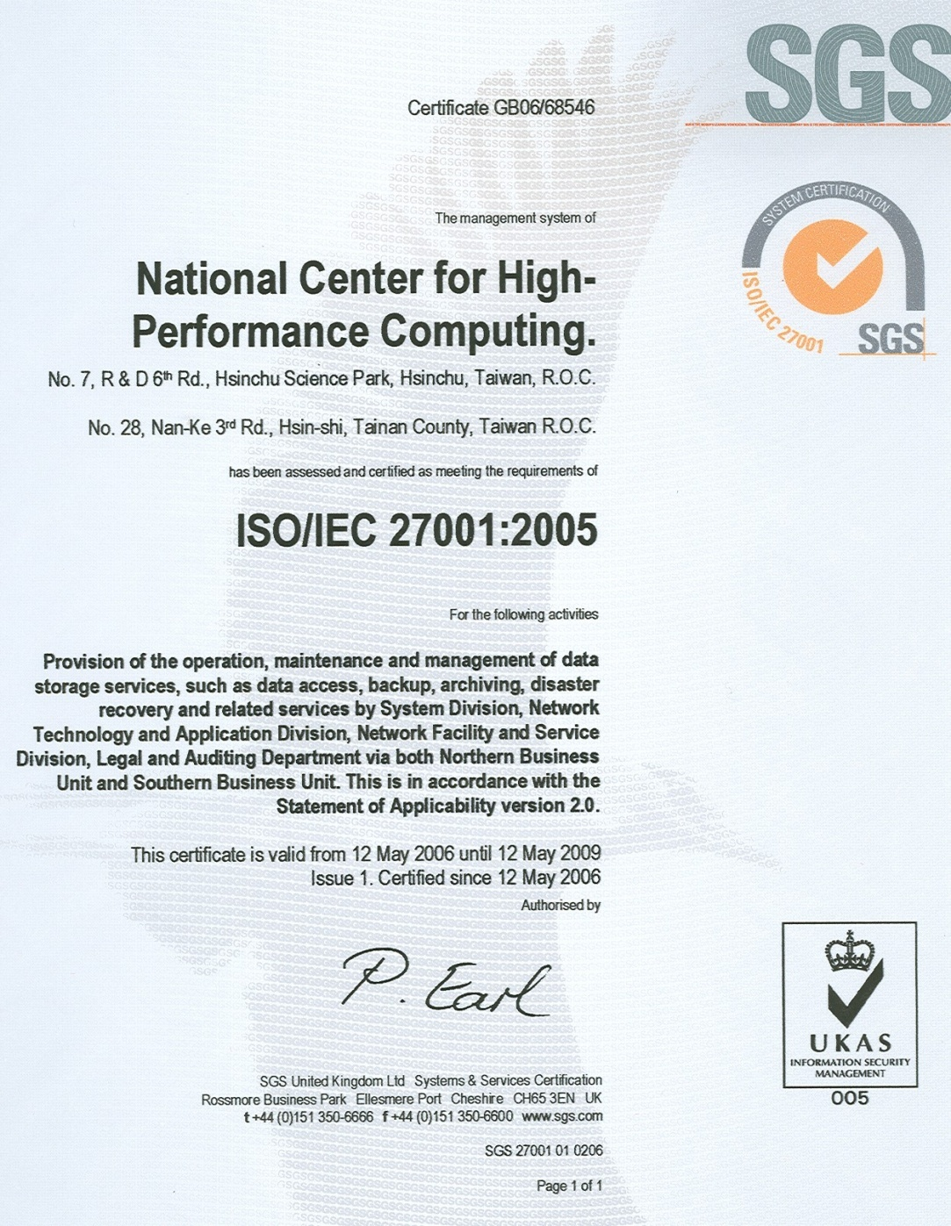
Security -
Physical Security (ISO 27001 & 9001)‏

Slide 4
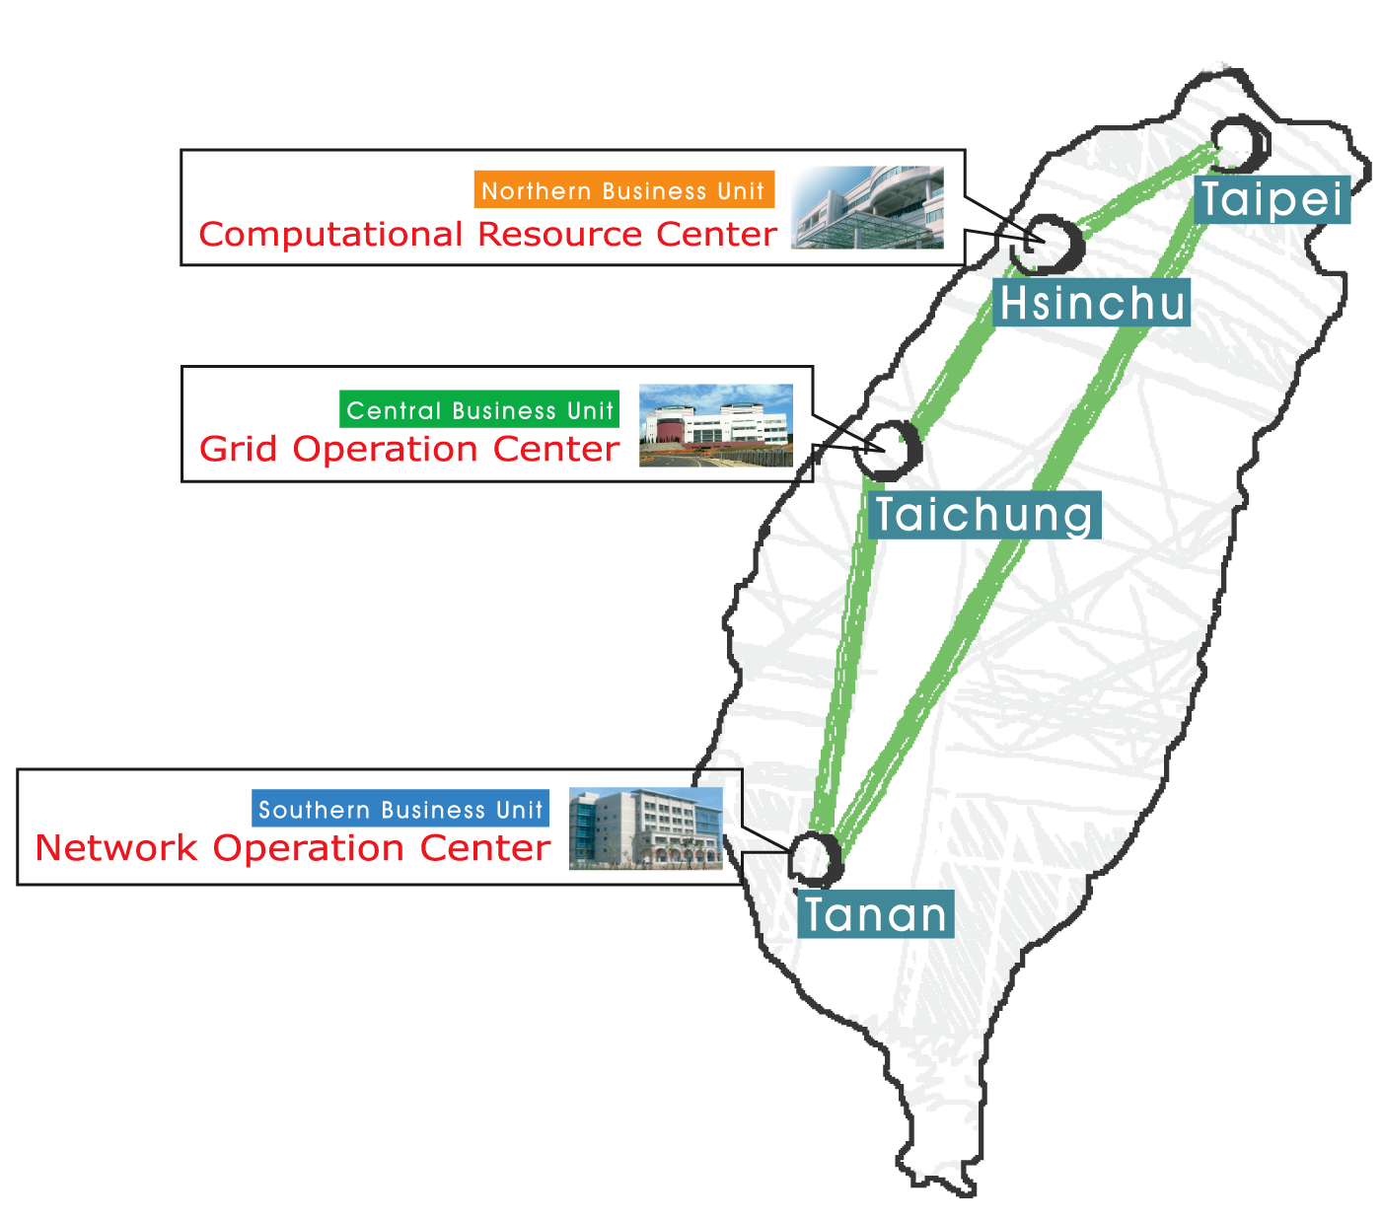
Introduction – NCHC
The only national supercomputing center in Taiwan
  Responsible for Taiwan’s cyberinfrastructure
  Providing services to whole academia and research community in Taiwan
Resources/Services
  Supercomputing
    Including Grid Computing
  Storage/archiving
  Advanced network
  Information technology

Slide 5
NCHC Grid Application
Computing Grid
Eco-Grid
Geo-Grid
Flood Mitigation Grid
Sensor Network
Co-Life/e-learning/Access Grid
Medical Grid Applications

Slide 6
NCHC CA Organization
NCHC Certificate Authority
NCHC CA PMA: Policy Management Authority
CA Manager:
  Manage all CA tasks
  Manage CA private key and its copy
  Approve CA and RA operator to operate affairs
RA Operator:
  Accept subscribing request
  Verify subscribers' information
CA Operator:
  Operate/maintain
    The CA signing server
    The CA web server
  Operate CA tasks
NCHC CA PMA
CA Manager
CA Operator
RA Operator

Slide 7
CP/CPS
Current version:1.1.0 (April, 2008)‏
Object ID: 1.3.6.1.4.1.23308.1.1.1.1.1.0
Conform to RFC 3647
Managed by the NCHC PMA
  Major changes
    Approved by the APGrid PMA community
  Minor changes
    Approved by the NCHC CA PMA
    Notify APGrid PMA via mail

Slide 8
End Entities
NCHC CA issues certificates for the following Users
  Users of NCHC
  Users of NARL
  Users/services involved in KING and TWAREN
    KING : Knowledge Innovation National Grid
    TWAREN : TaiWan Advanced Research and Education Network
  Users of domestic Grid-based applications or projects
  Collaborators related to NCHC Grid Computing research
  Users/services involving NCHC’s Grid Computing Resources

Slide 9
Publication and Repositories
Repositories
  http://ca.goc.nchc.org.tw
  NCHC CA certificate
  Certificates issued by NCHC CA
  Certificate Revocation List (CRL)
    signed by NCHC CA
  Copy of CP/CPS

Slide 10
Publication and Repositories
Publication
  Client certificate information used for Grid map file
  CA certificate
  CA certificate fingerprint
  CRL issued by NCHC CA
  Copy of CP/CPS
Access control
  Online, 24x7 availability
  Subjected to reasonable scheduled maintenance

Slide 11
Certificate Event -
Certificate Type
Issuer
  C=TW, O=NCHC, OU=GOC, CN=NCHC CA
User DN
  C=TW, O=[applicant's org], OU=[applicant's unit], CN=[the name of applicant with serial]
    Ex : /C=tw/O=nchc/OU=gtd/CN=Wei-Yu Chen 138621
Host DN
  C=TW, O=[applicant's org], OU=[applicant's unit], CN=[FQDN of the hostname]
    Ex: /C=tw/O=nchc/OU=gtd/CN=fs01.nchc.org.tw

Slide 12





Certificate Event -
Issuing Procedure (1)‏
Web Server (RA server)‏
1. Fill out the web enrollment form
2. Send a activate mail
3. Click the activate link to activate
Applicant
4. Inform RA OP
5. Interview applicant
6. Approve the applicant data
RA OP

Slide 13


Certificate Event -
Issuing Procedure (2)‏
7. Mail applicant include
( LicenseID, CSR-upload-
website, CSR-creation-help )‏
9. Checkout then
Inform CA OP
Web Server (RA server)‏
8. Login and upload
CSR file according mail
CA OP &
CA server
10. Copy the CSR file
through USB
11. Sign it
12. Approval from CA Manager
13. Copy to RA server then
publish information on web
14. Send successful
issuing mail to applicant
Applicant

Slide 14
Certificate event -- Validity
User certificate
  Activate e-mail address to avoid e-mail mis-spelling or stuffing attack
  Supply applicant configure file to create the correct CSR
  Compare with the contents of CSR and enrollment data
Host certificate
  Verify if the applicant is a subscriber of user certificate
  Create and check CSR in the same way as user certificate

Slide 15
Certificate event -- Identification
User certificate
  Applicant from NCHC
    RA check the badge ID of the applicant
  Applicant from other organization
    RA check personal information of the applicant
    Interview
Host certificate
  RA approve the subscriber’s title of the host FQDN

Slide 16
Certificate Revocation/Suspension
When to revoke?
  When there is suspected security problems
    Compromise of subscriber's private key
    Incorrectness of subscriber’s information
    Subscriber violate obligation which might cause security problem
    Subscriber leaves his/her organization
    Host/service is retired
Who can request revocation
  Any other entity presenting evidence of circumstances that the criteria described in section 4.2.1 has been violated
  Any entities presenting evidence of the compromise of associated private key

Slide 17
Certificate Revocation/Suspension
Procedure of revocation
  Subscriber send a revocation request to NCHC CA
  RA should authenticate the subscriber as described previously
  RA forwards revocation request to CA
  CA will
    Revoke the certificate
    Update the signed CRL in NCHC CA publication
    Send revocation notice to subscriber
Time frame
  CA should process ASAP, w/o grace period
  CA processing time is 1 working day

Slide 18
Certificate Revocation/Suspension
CRL (Certificate Revocation List)
  Valid for 30 days
  New CRL issued
    7 days before expiration of current CRL
    Immediately after a certification revocation
Certificate Lifetime
  End entity certificate
    1 year
  CA certificate
    10 years

Slide 19
End of Subscription
Subscriber
  Must not use any certificate issued from NCHC CA
CA
  Must revoked all certificates issued for the subscriber

Slide 20
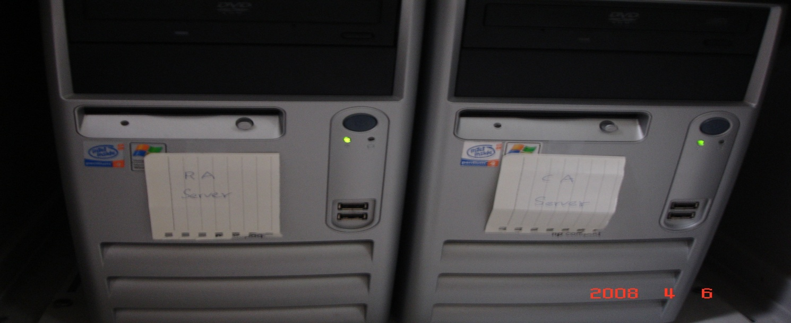
CA/RA System Information
 | CA server | Web Server/RA server
Hardware | HP DX 7200 | HP DX 7200
System | Ubuntu 7.10 | Ubuntu 7.10
Network | Off-line | On-line (w/firewall)
UPS (battery + generator) | Supplied | supplied
AC | Supplied | supplied

Slide 21
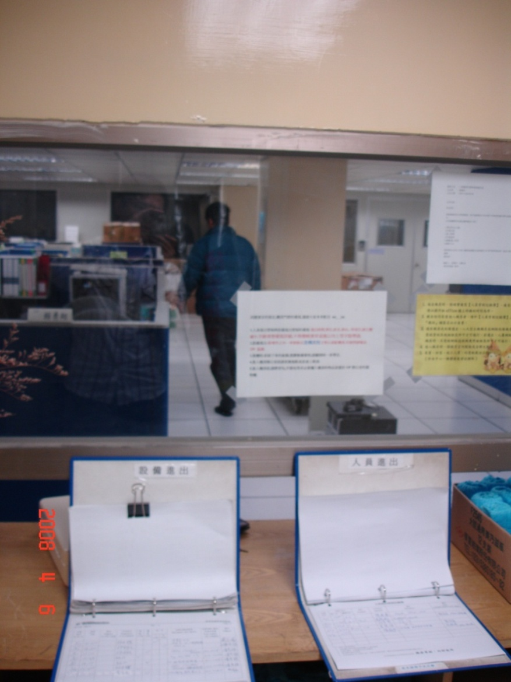
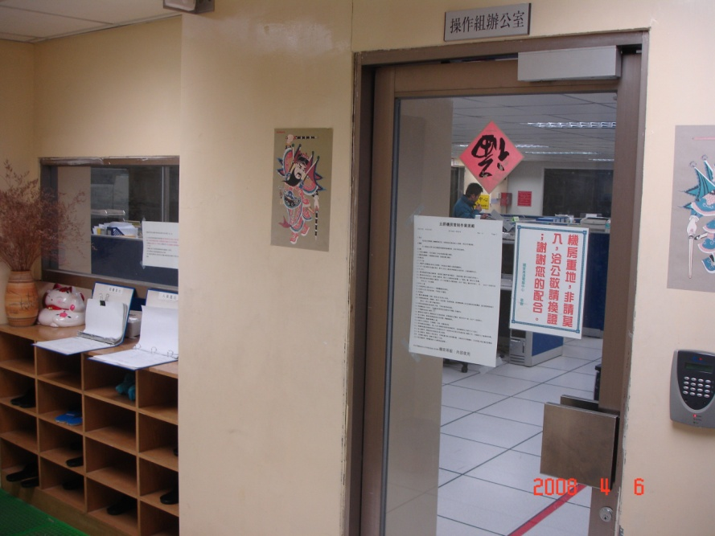
Physical Security
Entrance guards and security door 1

Slide 22
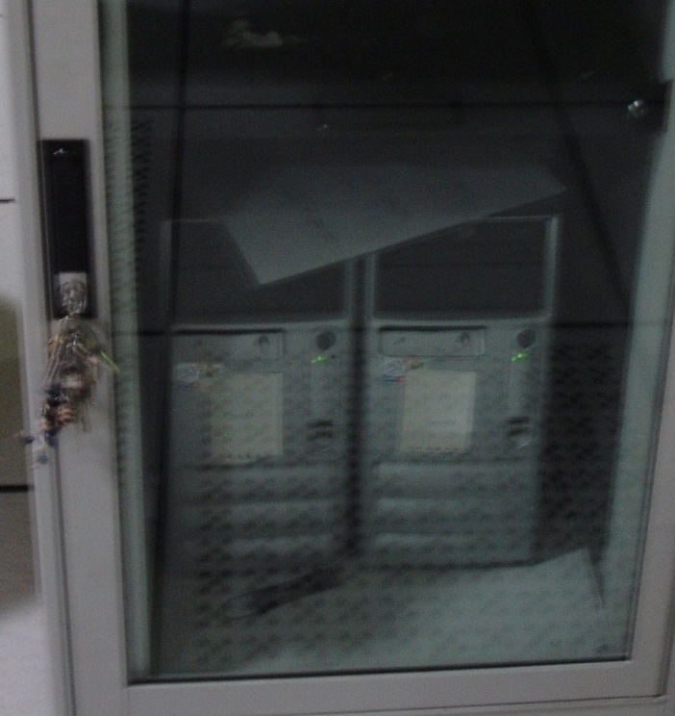
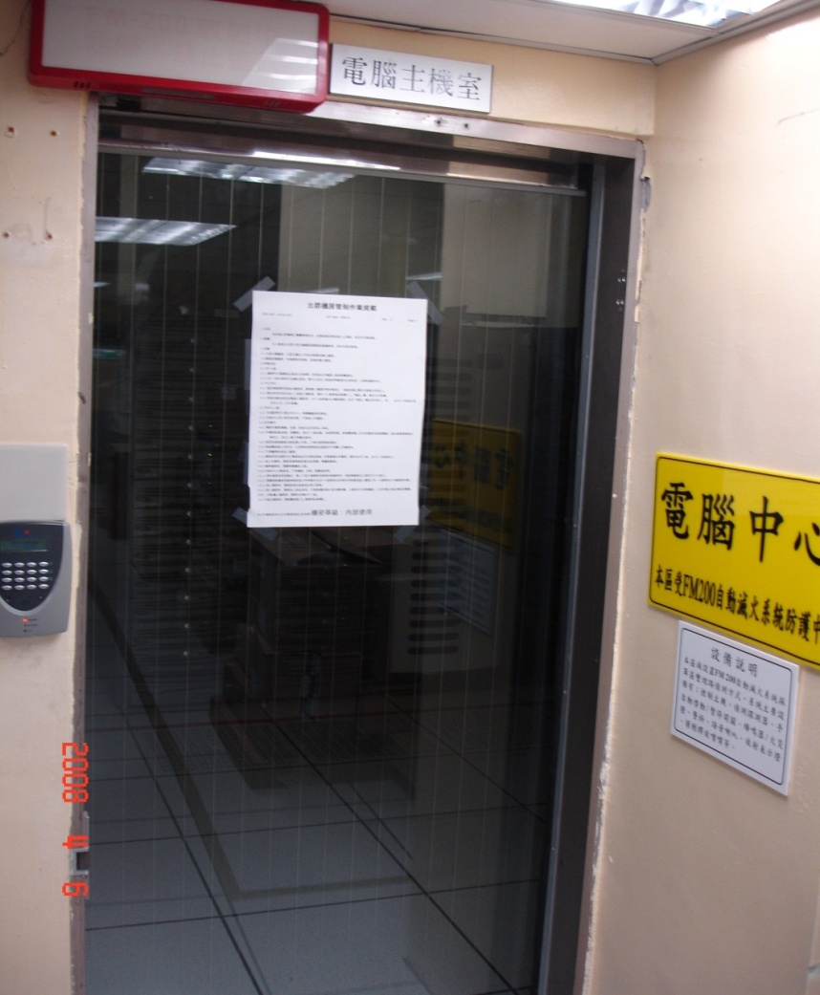

Physical Security
Security door 2
Cabinet w/key

Slide 23
Physical Security
Machine
  OP monitored
  NOC monitored
ISO 9001
  Operation of machine room
  Operation of data storage
  NCHC internal auditing, at least, once per year
  External auditing, once per year
ISO 27001
  Information security
  NCHC internal auditing, at least, once per year
  External auditing, once per year

Slide 24
Key Pair and Certificate Usage
Key length
  CA Certificate : 2048 bits
  End Entity Certificate : 1024 bits
  sha1WithRSAEncryption
CA private key
  generated by CA operator
  Using OpenSSL
User and Grid Host key pair
  generated by user
  Using OpelSSL

Slide 25
Key Pair and Certificate Usage
NCHC CA certificates may be used for any software for grid computing.
The certificates could be used in other capacities, but not recommend and no warranty
User certificates must not be shared
Host certificates must be linked to a single network entity
The subscriber must manage his certificates and private keys securely
  must encrypt his private with a pass phrase
  the pass phrase must not be less than 12 characters long.

Slide 26
Certificate Management
Renewal
  Do not permit
Re-key
  Revoke first, then, regenerate
Modification
  Not supported

Slide 27
Records Archival
Types of archive data:
  All certificates and the CRLs
  All enrollments or revocations, including all supporting documents, submitted by users
  All records related to the CA key
  All auditing records
  This CPS and operational procedures documents
  Other important materials related to decisions of the NCHC PMA
Retention period is 3 years
Archived files are stored in CD-ROM which is stored in a safe box.

Slide 28
Internal Auditing
First Auditing
  2008/1/25
  Refine CA procedure
  Based on checklist provided of APGrid PMA
Second Auditing
  2008/3/17
  Check overall procedure
  Conform to checklist provided of APGrid PMA

Slide 29
Internal Auditing
First internal auditing
  2008/01/25
  Procedure refinement
  Based on checklist provided by APGrid PMA
  Enhancement identified/improved
Second internal auditing
  2008/03/17
  Reconfirm overall procedure
  Conform to checklist provided by APGrid PMA

